Slide 1
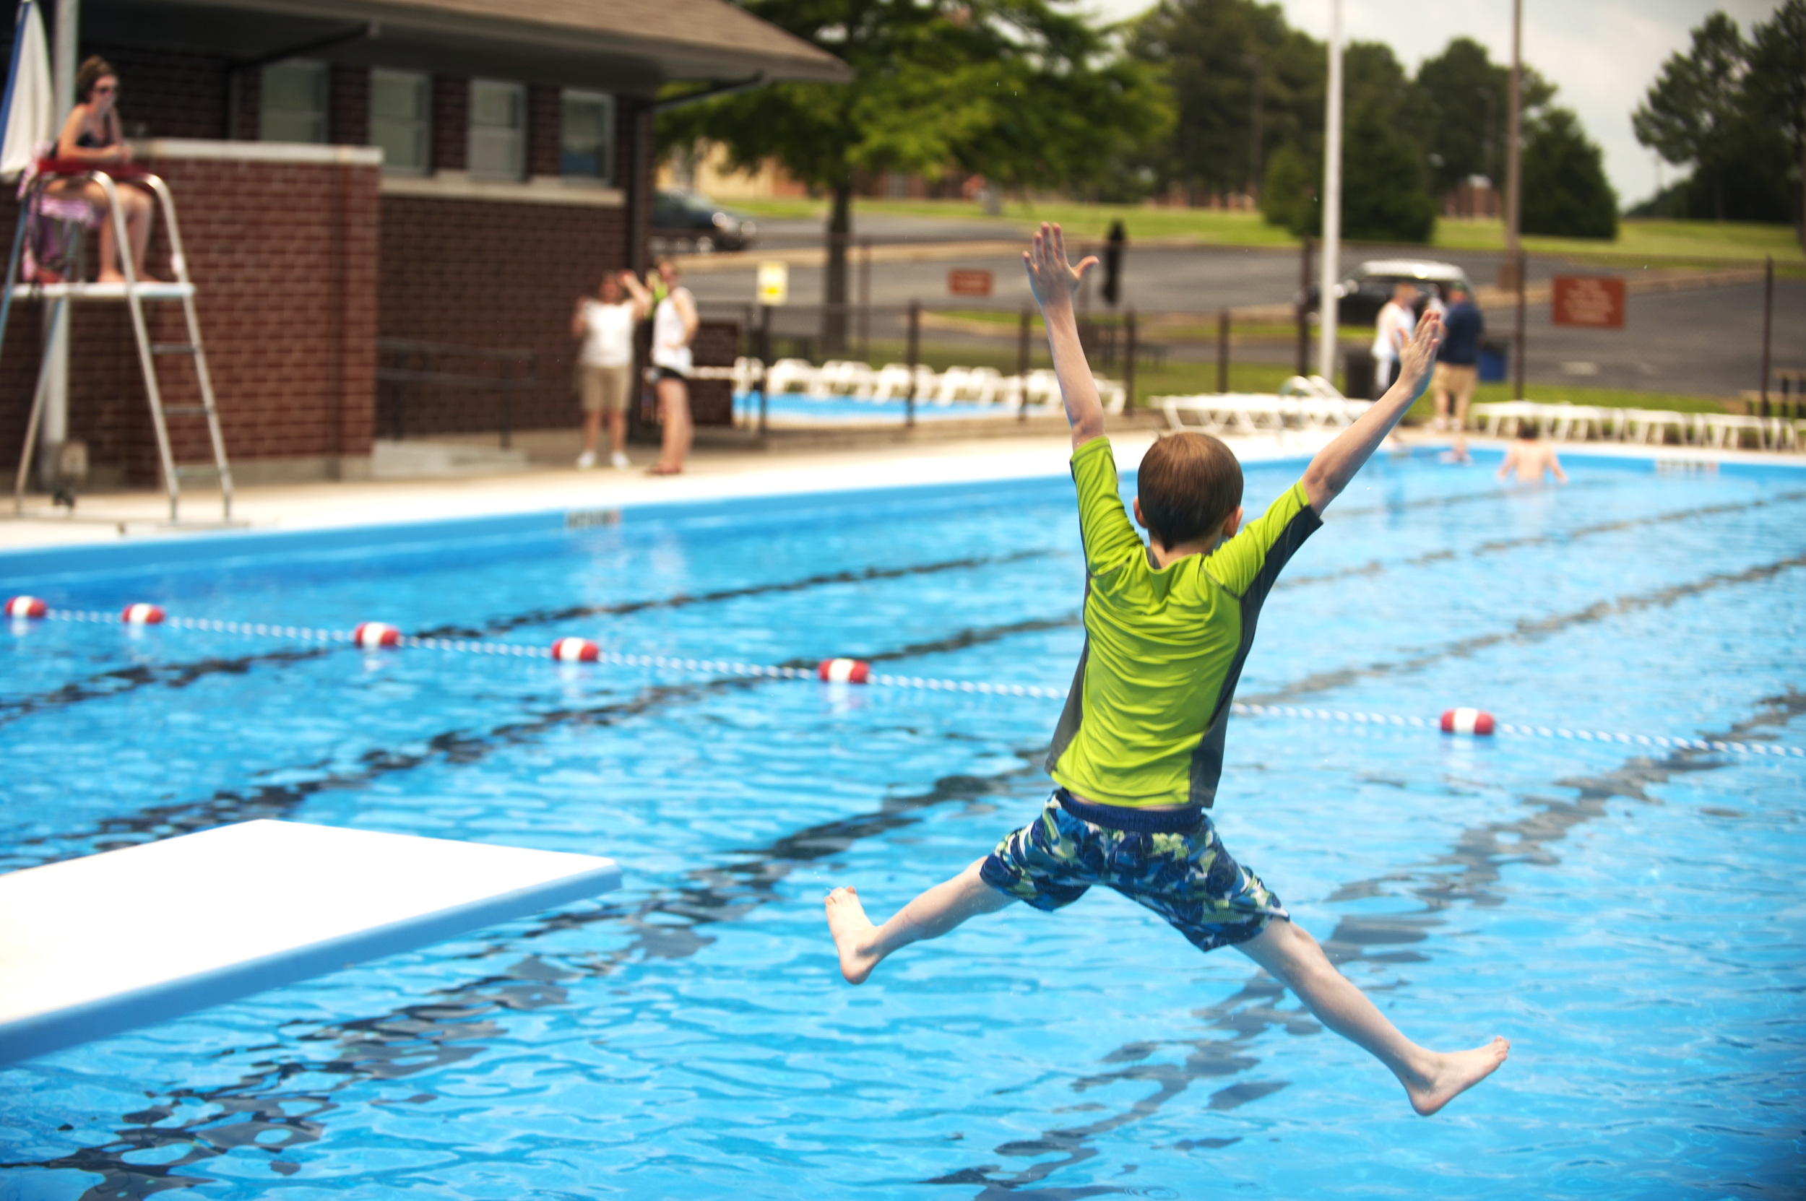
GRAVITY
We will explain how gravity affects objects on Earth

Slide 2
Repeat the opposite word/phrase.
BALANCED FORCE
EQUAL IN OPPOSITE DIRECTIONS

Slide 3
Repeat the opposite word/phrase.
UNBALANCED FORCE
UNEQUAL OR SAME DIRECTION

Slide 4
Repeat the opposite word/phrase.
CONTACT FORCES
PHYSICAL CONTACT

Slide 5
Repeat the opposite word/phrase.
NON-CONTACT FORCES
NO PHYSICAL CONTACT

Slide 6
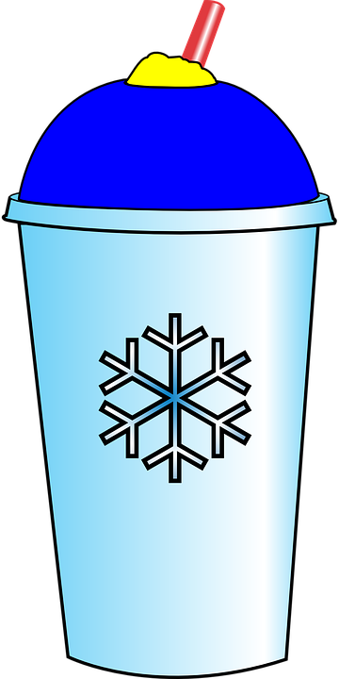
Calculate the net force from the diagram below.
10N
20N

Slide 7
We will explain₁ how gravity affects₂ objects on Earth
TRACK WITH ME
READ WITH ME
We will define gravity
We will compare weight and mass
We will use examples to explain gravity
DEFINITION
1 - describe 2 - impacts
DECLARE THE OBJECTIVE
Read the learning objective to your partner.
Notes:
Learning Objectives contain concepts (nouns, big ideas), skills (verbs, measurable behaviours) and sometimes context (restricting or targeting conditions).
●Example: Students will be able to describe the concept of density and apply it to floating and sinking.
●
Success criteria are specific measurable outcomes that if met mean that the student has met the learning objective.
Examples:
•Students will be able to compare densities of substances using mass and volume.
•Students will be able to identify whether a solid or liquid will float or sink in a liquid based on their densities.

Slide 8
We will explain how gravity affects objects on Earth
Categorise the following examples as contact or non-contact forces.
Examples | Contact Force | Non-Contact Force
Dropping your slushie at the petrol station
Using your iPad
Throwing a discus
Discus falling to the ground
MAKE THE CONNECTION
Students, you already know that forces occur when two objects interact. Our Earth interacts with all objects.

Slide 9
We will explain how gravity affects objects on Earth
Categorise the following examples as contact or non-contact forces.
Now try and identify which of the examples are due to gravity.
Examples | Contact Force | Non-Contact Force
Dropping your slushie at the petrol station
Using your iPad
Throwing a discus
Discus falling to the ground
MAKE THE CONNECTION
Students, you already know that forces occur when two objects interact. Our Earth interacts with all objects.

Slide 10
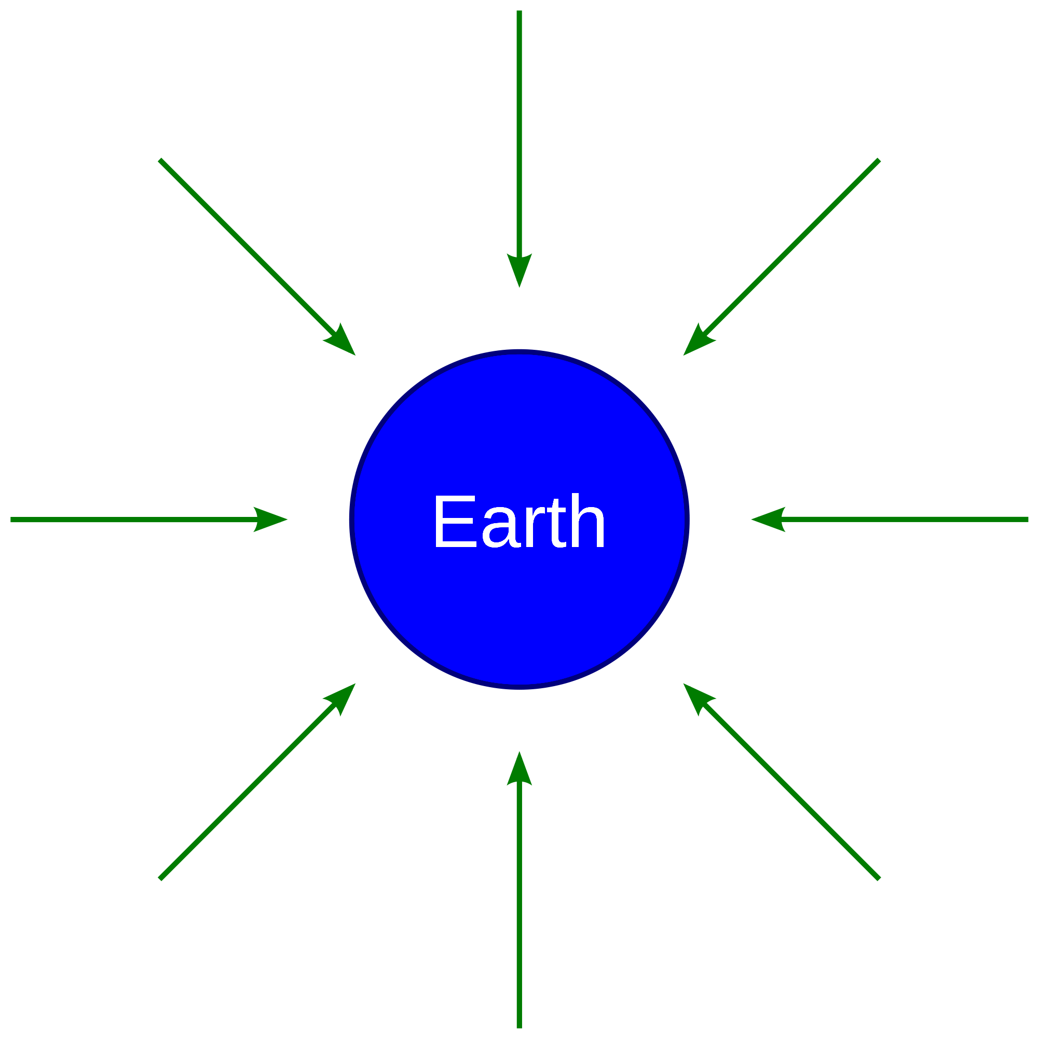
We will explain how gravity affects objects on Earth
Gravity is a force that pulls objects towards the centre₁ of the Earth.
Every object made from matter₂ has gravity.
The more matter an object has, the stronger the gravitational pull.
CHECK FOR UNDERSTANDING
Please order the following objects from smallest gravitational field to largest. Justify your answer. Moon Jet ski Earth Human Kettle
The Earth is made up of a huge amount of matter and so has a large gravitational field surrounding it.
DEFINITION
1 - middle 2 - physical substance

Slide 11
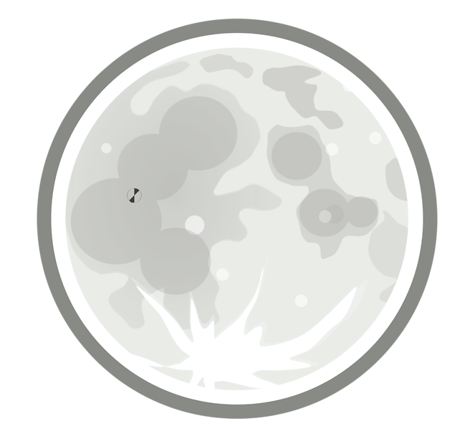
We will explain how gravity affects objects on Earth
Gravity is a force that pulls objects towards the centre₁ of the Earth.
Weight is a measure of the gravitational pull on an object. Being a force, we use newtons to measure weight.
Mass is a measure of the amount of matter₂. We use kilograms to measure mass.
Mass of an object doesn’t change but weight can. For example, on the Moon your weight is different!
CHECK FOR UNDERSTANDING
Would your mass be different on the Moon? Justify your answer.
DEFINITION
1 - middle 2 - physical substance

Slide 12
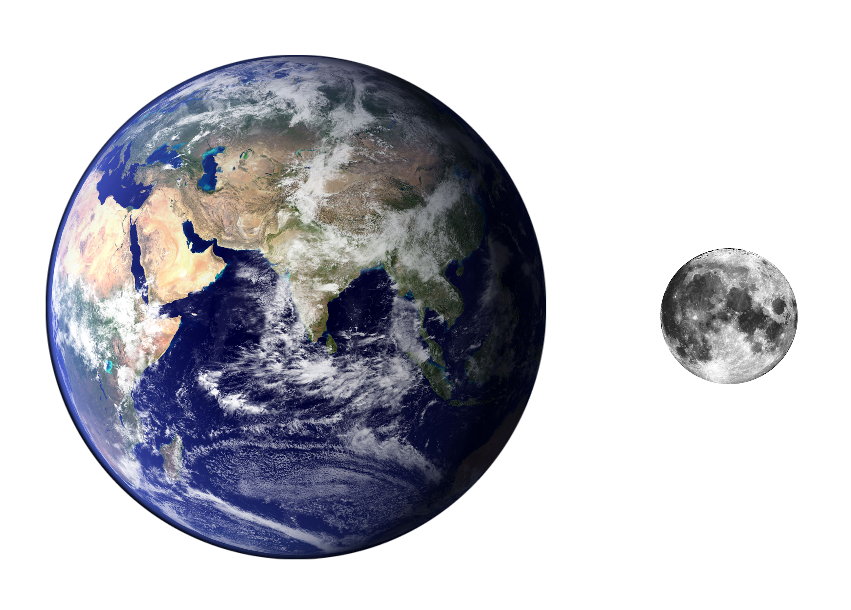
We will explain how gravity affects objects on Earth
Gravity is a force that pulls objects towards the centre₁ of an object.
The more matter₂ an object has, the stronger its gravitational pull.
CHECK FOR UNDERSTANDING
Which would have a greater gravitational pull - the Earth or the Moon? Why?
DEFINITION
1 - middle 2 - physical substance

Slide 13
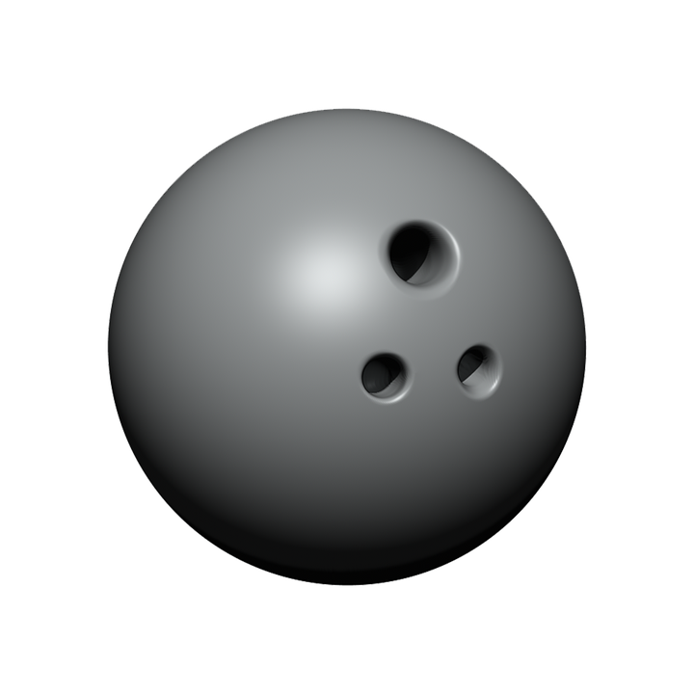

We will explain how gravity affects objects on Earth
Gravity makes all objects fall towards Earth at the same rate, regardless of how big or heavy they are.
It is expected that heavier objects fall to Earth faster than lighter objects, but this is not always the case!
In a vacuum₁, a bowling ball and a basketball (of equal size) hit the floor at the same time.
DEFINITION
1 - space with no air

Slide 14
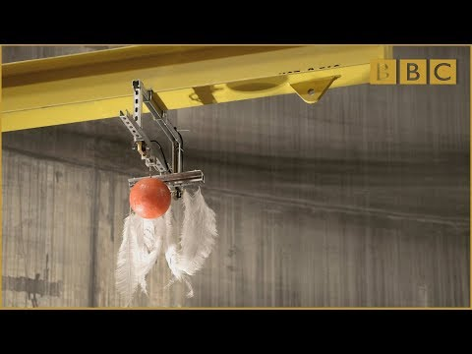
We will explain how gravity affects objects on Earth
CHECK FOR UNDERSTANDING
What caused the feather and bowling ball to fall at different speeds?

Slide 15
We will explain how gravity affects objects on Earth
Using the diagram below, answer the following questions.
What happens to an object that is located within Earth’s gravitational field?
What happens to the strength of this gravitational field as an objects further away from Earth?
CHECK FOR UNDERSTANDING
Why is gravity called a non-contact force? Justify your answer.
REMEMBER THE CONCEPT
Remember that gravity is a force that pulls objects towards the centre of the Earth.
The arrows represent₁ Earth’s gravitational field.
DEFINITION
1 - show

Slide 16
We will explain how gravity affects objects on Earth
Gravity makes all objects fall towards Earth at the same rate, regardless of how big or heavy they are.
Heavier objects require more force to move but also have a greater gravitational field.
An heavier object’s gravitational field exactly counteracts₁ the extra force needed to move it, meaning it hits the ground at the same time as objects that are lighter.
CHECK FOR UNDERSTANDING
An empty bottle and a bottle full of water were dropped from a height. Which one would hit the ground first? Justify your answer.
DEFINITION
1 - balances

Slide 17
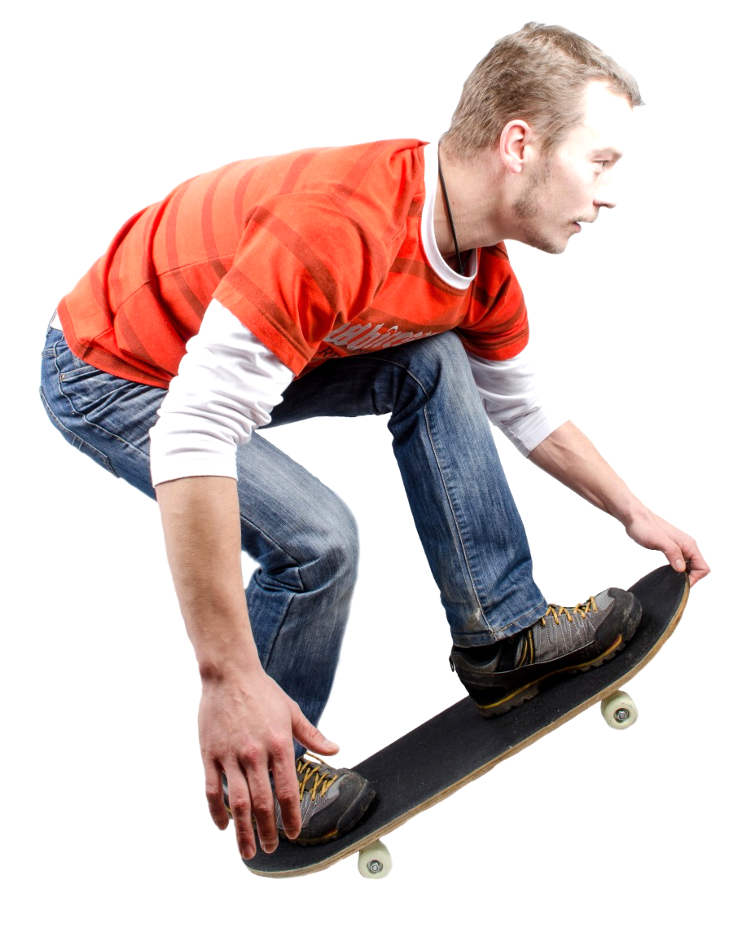
We will explain how gravity affects objects on Earth
Gravity is a force that pulls objects towards the centre₁ of the Earth.
CHECK FOR UNDERSTANDING
Why do things fall to the ground on Earth? Justify your answer.
Gravity affects₂ all things on Earth and so must be considered₃ when measuring any force.
Remember that it is very likely that multiple forces are impacting an object.
DEFINITION
1 - middle 2 - impacts 3 - remembered

Slide 18
We will explain how gravity affects objects on Earth
Gravity is a force that pulls objects towards the centre₁ of the Earth.
Mass measures the amount of matter and weight measures the force of gravitational pull.
Objects with greater mass, have greater gravitational pull.
Objects with different mass and with equal size/shape, hit the ground at the same time.
CHECK FOR UNDERSTANDING
If we were conducting an experiment on when objects of different mass hit the ground, why do the objects need to have the same shape? Justify your answer.
DEFINITION
1 - middle

Slide 19
We will explain how gravity affects objects on Earth
What happens to a person’s weight if they travelled to the Moon?
What is the difference between gravity on the Earth and gravity on the Moon?
Describe₁ how walking on the Moon would feel.
CHECK FOR UNDERSTANDING
Does gravity push or pull objects to the centre of the Earth? Explain.
REMEMBER THE CONCEPT
Remember that gravity is a force that pulls objects towards the centre of the Earth. Remember that weight and mass are different.
Gravity on the Earth and the Moon is different.
DEFINITION
1 - explain
Notes:
Please include tasks/questions here rather than just referring to a worksheet. This will save on photocopying and facilitate sharing with other schools.
Try and build tasks/questions which escalate through Bloom’s Taxonomy. This will help with differentiation.

Slide 20
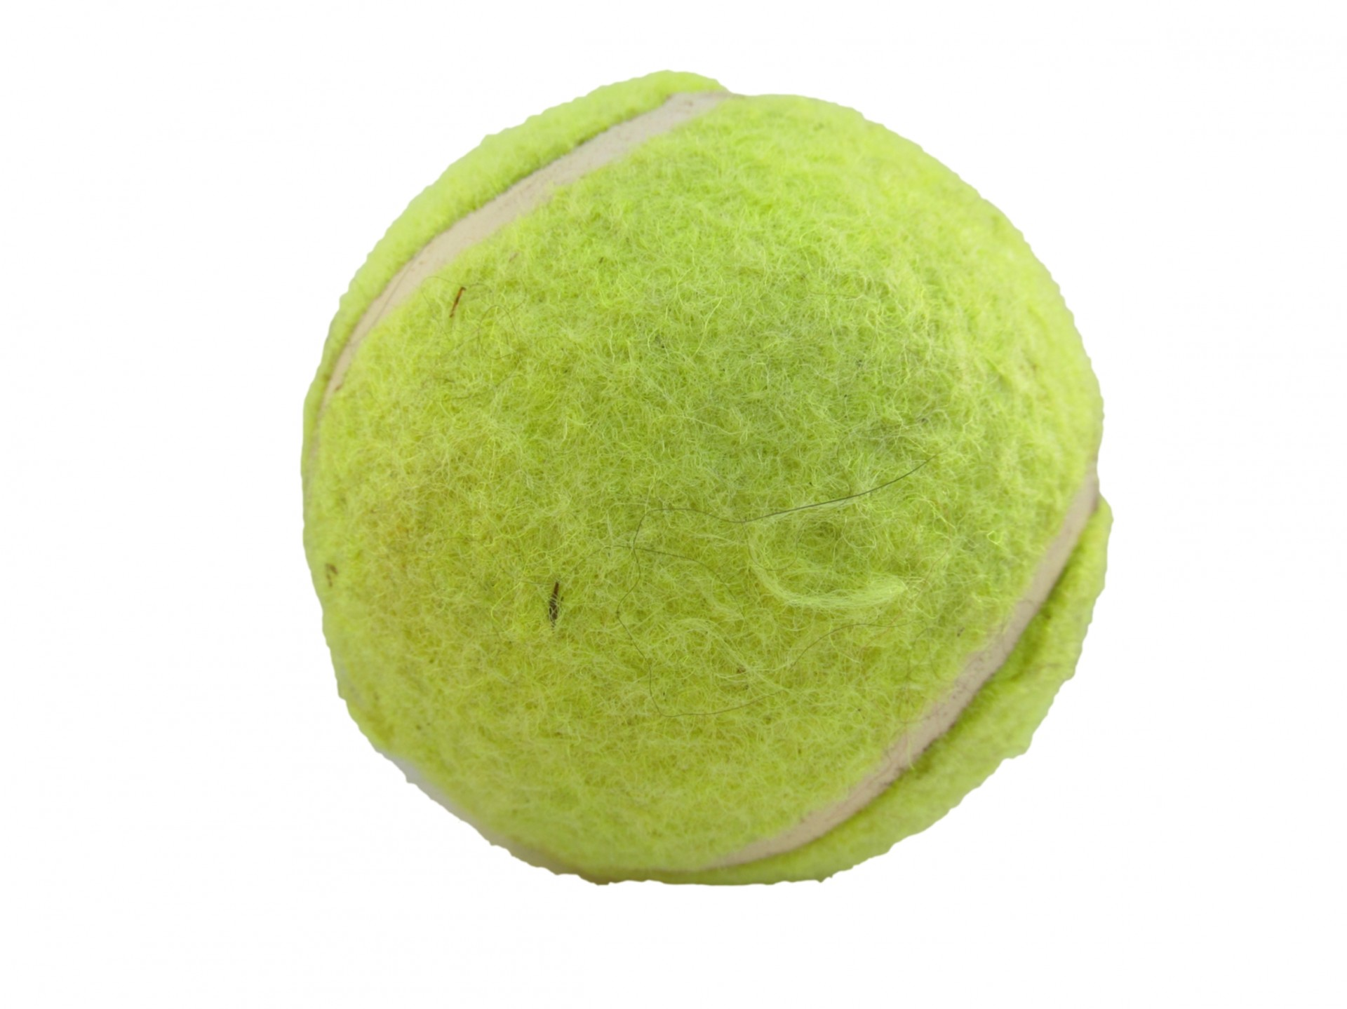
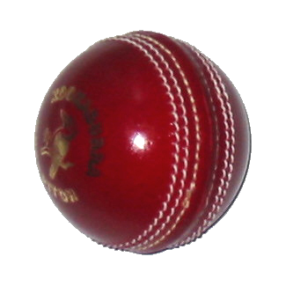
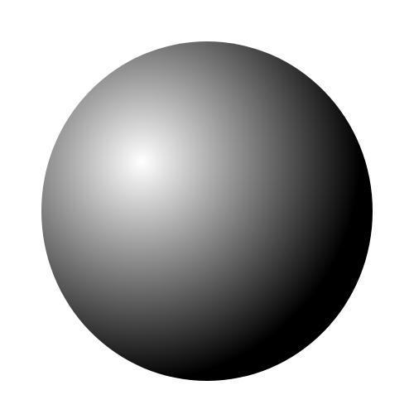
We will explain how gravity affects objects on Earth
Which of the objects below would hit the ground first? Explain.
Explain whether this would be any different on the Moon.
CHECK FOR UNDERSTANDING
Explain why objects of different mass (but same shape and size) hit the ground at the same time when dropped.
A tennis ball, a cricket ball and a shot put are all dropped at the same time.
REMEMBER THE CONCEPT
Remember that gravity is a force that pulls objects towards the centre of the Earth.
Notes:
Please include tasks/questions here rather than just referring to a worksheet. This will save on photocopying and facilitate sharing with other schools.
Try and build tasks/questions which escalate through Bloom’s Taxonomy. This will help with differentiation.

Slide 21
We will explain₁ how gravity affects₂ objects on Earth
We will define gravity
We will compare weight and mass
We will use examples to explain gravity
DEFINITION
1 - describe 2 - impacts
CHECK FOR UNDERSTANDING
Check Success Criteria.

